Slide 1
CS118: Computer Network Fundamentals Lecture-1: introduction

Slide 2
CS118: explains (roughly) how the Internet works
Internet: a huge, complex network of networks
Divide-and-conquer
Figure out how many major parts,
Learn one piece at a time
Your job:
Read textbook, think, collect a list of questions
review every lecture slide deck after each class
Ask questions in class/office hours/via Piazza
Practice what you learn through homework and projects

Slide 3


Slide 4
Course assignment and due schedule
Midterm | In-class, Wednesday Feb 5 (Location TBD)
Final | 3:00PM-6:00PM Saturday March 21 (Location TBD)
Homework | Release: on Thursday of week 1, 3, 5, 7; Due: 11:59pm Tuesday of week 3, 5, 7, 9.
Project 0 | Release: Monday Jan 6, 2024 (Week 1) Due: 11:59pm Wednesday, Jan 15, 2024 (Week 2)
Project 1 | Release: Thursday Jan 16, 2024 (Week 2) Due: 11:59pm Sunday, Feb 16, 2024 (Week 6) Grading: auto-grading script (sample tests will be provided to let everyone test their code before submission)
Project 2 | Release: Monday, Feb 17, 2024 (Week 7) Due: 11:59pm Sunday, March 16, 2024 (Week 10) Grading: auto-grading script (sample tests will be provided to let everyone test their code before submission)
1.5 weeks
4.5 weeks
4 weeks
For all other course info, please see https://bruinlearn.ucla.edu/

Slide 5
Course workload and grading
Bi-weekly homework assignments
3 programming projects,
0. UDP socket (individual)
1. Reliable data delivery (2-3 people team)
2. Secured reliable data delivery (2-3 people team)
Midterm and final exams (cheat sheets allowed, 2 pages double sided)
Strict Grading Policy
Homework: do it yourself; no credit for late submission
Project: 20% credit reduction per late day
No make-up exam
Homework | 20%
Programming Projects | 25% (5/ 10/ 10)
Midterm | 25%
Final exam | 30%
2% extra credits based on piazza
1% extra credits course evaluation and TA/LA feedbacks
Notes:
Whether allow cheat sheer

Slide 6
Class Policy
The following actions are strictly prohibited
Posting/sharing/selling class material, with or without answers, to anyone outside this class, during or after this quarter.
Use of old homework/midterm/finals in doing homework or exams
Use ChatGPT in doing assignments
Making your project code publicly available either during or after this quarter
you must use private repository on GitHub or GitLab
Notes:
plagiarism You can learn a lot from your classmates here at UCLA, so I strongly encourage you to try to get to know one another. The time before class starts is a great opportunity to talk with other students. Our cellphones can be very distracting, and often prevent us from getting to know people. Accordingly, as soon as you enter this room, please turn off your cellphone and put it away. This room should be a cell-phone free zone. If you really need to use your phone before class, please step out of the room and use it outside. I think you will find spending time away from your phone, and with the actual people around you, to be very worthwhile.

Slide 7
Hints for Getting Good Grade
Review previous lecture slides
Read textbook before coming to each lecture
Ask questions
Get your work done early
Lecture slides uploaded to BruinLearn one day before the lecture
Get HWs and projects done before the deadline
Notes:
have Thu lecture uploaded tonight

Slide 8
Let’s get started Today we cover the basic concepts in Chapter 1 of the textbook

Slide 9




What is a Computer Network
Internet
Notes:
Can end user devices talk to each other directly? What if one does skype

Slide 10
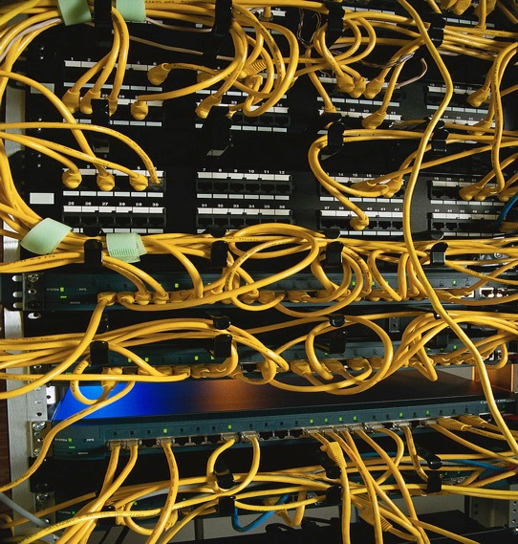

What is a Computer Network
Notes:
This is a rather traditional picture, not the latest greatest

Slide 11
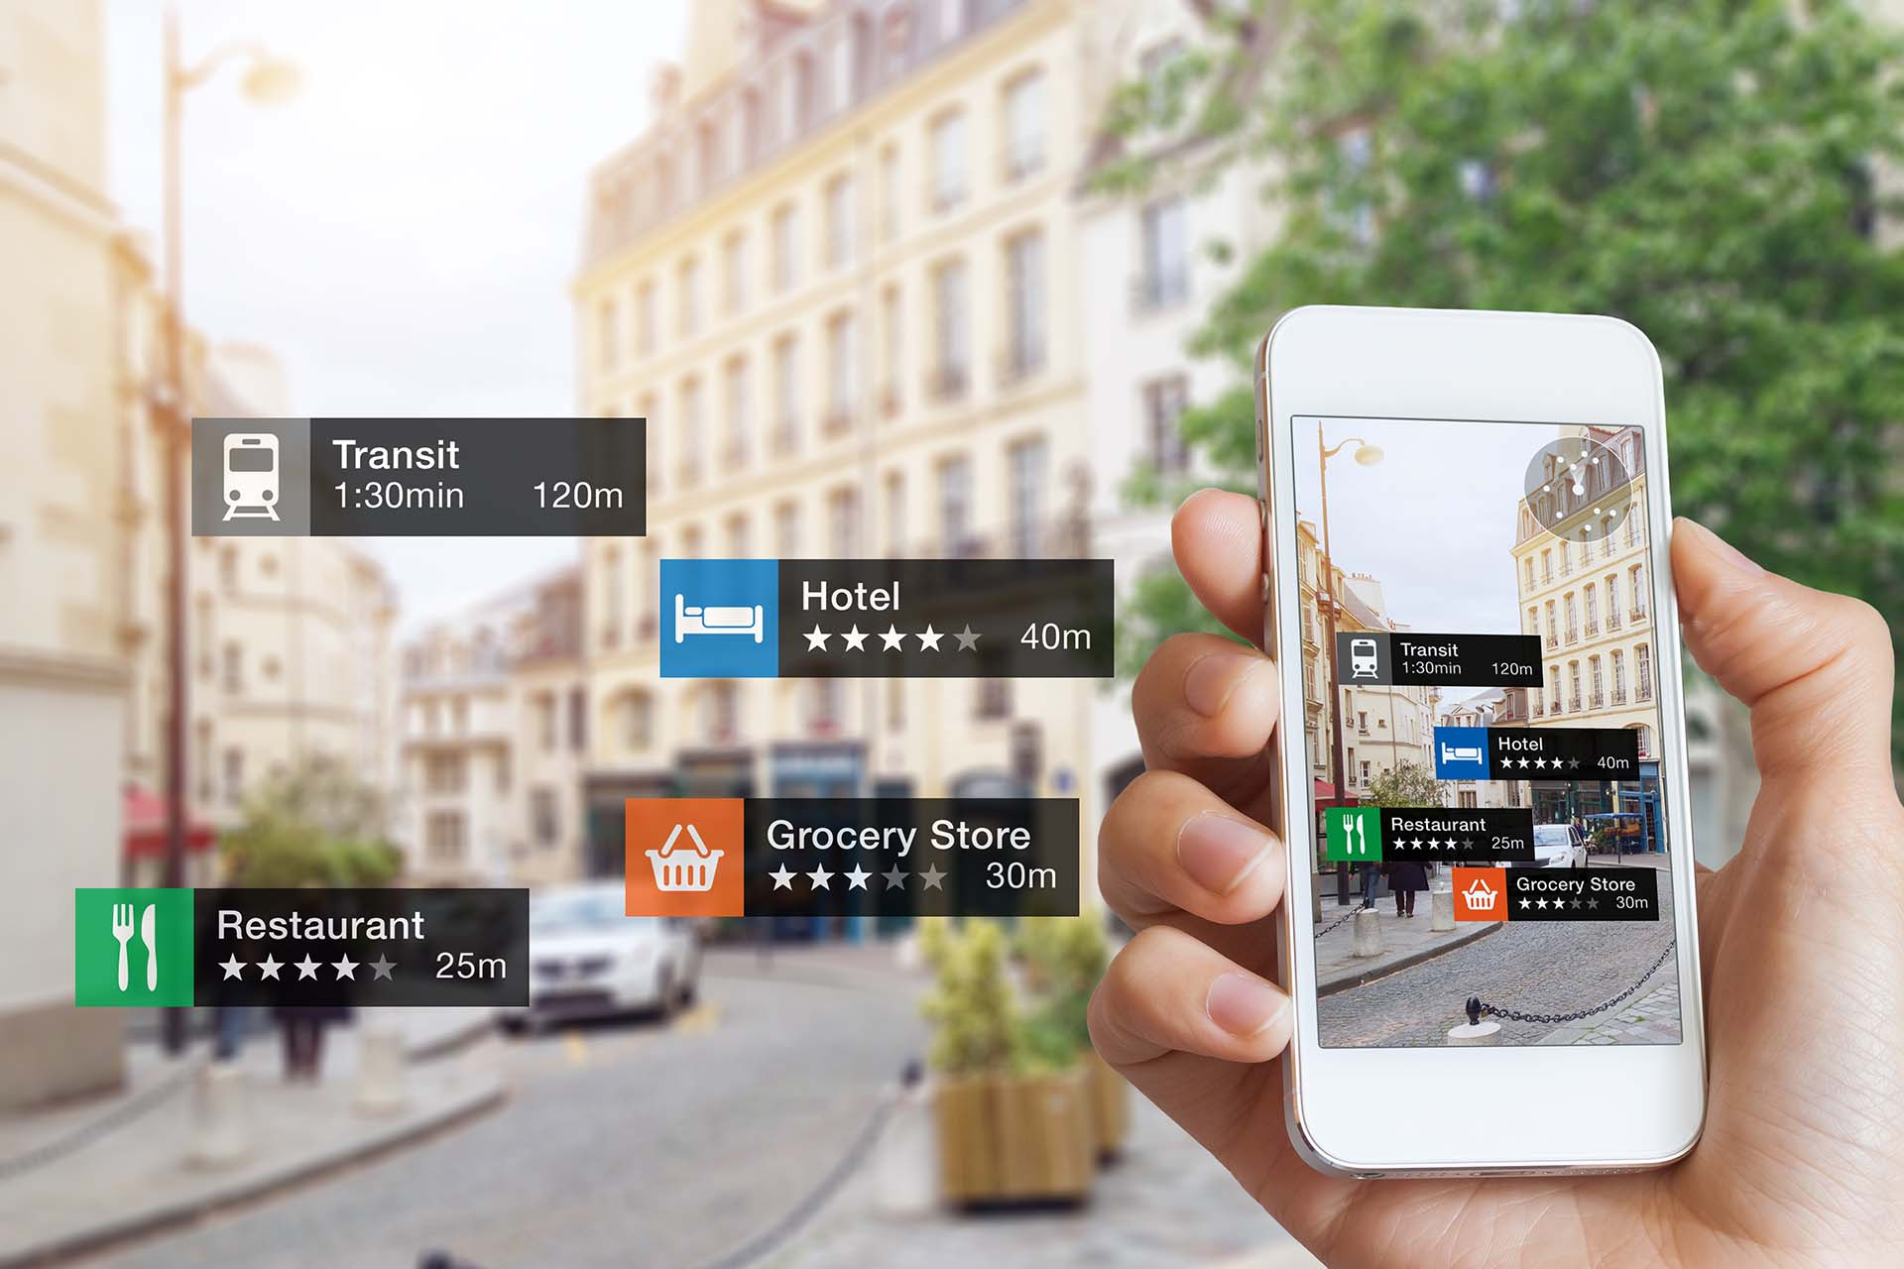

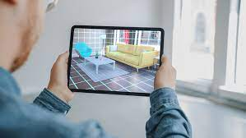
Coming to you ....

Slide 12




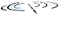

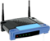


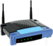



Terminology
billions of connected computing devices:
hosts = end systems
running network apps
Apps send/receive data packets
PC
mobile network
server
global Internet
Service Provider
(ISP)
wireless
laptop
smartphone
home
network
regional ISP
Routers = packet switches inside network
router
communication links
fiber, copper, radio, satellite
transmission rate = bandwidth (BW)
wireless
links
institutional
network
wired
links
Recent years witnessed rapid growth of giant cloud service providers
Notes:
12

Slide 13
“Nuts and Bolts”
Internet: “network of networks”
Interconnected ISPs, enterprise networks, now also cloud service providers
Protocols: define how to send, receive packets
e.g., HTTP, TCP, IP, 802.11
Internet protocol standards
RFCs: “Request for Comments”
https://www.rfc-editor.org/rfc-index.html
Developed by Internet Engineering Task Force (IETF)
IEEE Standards
W3C (World Wide Web Consortium), and others
mobile network
global ISP
home
network
regional ISP
institutional
network

Slide 14



What is a protocol?
Traffic light protocol
Green: go
Red: stop
Yellow: slow down - stop
… specific messages sent
… specific actions taken when the messages received
human protocols:
computer protocols:
Hi
TCP connection
request
Hi
TCP connection
response
Got the
time?
2:00
Get http://www.awl.com/kurose-ross
<file>

Slide 15
Internet protocols
Communication between machines rather than humans
all communication activity governed by protocols
computer protocols:
TCP connection
request
TCP connection
response
protocols define format, order of packets sent and received among network entities, and actions taken on packet transmission, receipt
Get http://www.awl.com/kurose-ross
<file>
Notes:
This course covers basic Internet protocols, enough for you to get a basic idea on how Internet works. Now how many protocols out there? A lot, group them together by layers

Slide 16
Delivering data over the global Internet is a complicated process, involving many many steps
How to get the work done: divide and conquer
Group functions to a few modules
How many?
Notes:
Dealing with complex systems: “Divide and conquer” principle. So each piece is manageable. Easier said than done. Hard problem? Is 7 a lucky #? Or 3 is better? How do people figure out the right number?

Slide 17
Internet protocol stack
Application layer protocols
Support data exchange between application processes
Example: SMTP, HTTP, DNS
Transport layer protocols
handling delivery reliability, multiplex within a host
Example: TCP, UDP
Network layer protocols
forward packets from source to destination
Example: IP
Link layer protocols
transfer data between directly connected network elements
Example: Ethernet protocol, WiFi
Physical layer: bits “on the wire”
(Simple Mail Transfer Protocol)
application
transport
network
link
physical
Notes:
At least some of the protocol stack runs on every node/element/box that is connected to the network
explicit structure allows identification, relationship of complex system’s pieces
layered reference model for discussion
modularization eases maintenance, updating of system
change of implementation of layer’s service transparent to rest of system
e.g., change in gate procedure doesn’t affect rest of system

Slide 18
Application View
apps
trans
net
link
phy
My Laptop -
Running web
browser
Web Server
www.cnn.com
Internet
client
server
(Chrome, Safari, Firefox, ...)
(Apache, GWS, ...)
These are application programs
They talk to each other using application protocols (web protocol: HTTP)
Application protocols
Assume network can send data to any hosts on the Internet
Don’t know/care how data is sent, and assume all data delivered reliably
Runs on top of a transport protocol
Notes:
(process: running application)

Slide 19
Transport View
apps
trans
net
link
phy
My Laptop -
Running web
browser
Web Server
www.cnn.com
Internet
client
server
A transport protocol's job: delivering data between the two communicating ends
Don’t know or care about which paths data may traverse through the network
Multiple transport protocols exist, each offers somewhat different functions (e.g. reliability, congestion control)
Actually, transport protocols don’t do delivery → network protocol’s job
Notes:
Transport protocol runs on end hosts

Slide 20
Network Layer View
apps
trans
net
link
phy
ISP B
Internet
ISP A
ISP C
ISP E
“BIG COMPANY’s network”
network protocol's job: forward packets from source to destination host
A really hard problem: the Internet is large, run by many different parties
connection from laptop to CNN.com:
WiFi → campus backbone → local ISP → other ISP → CNN website
Notes:
Because the Internet is huge!

Slide 21
Link Layer View
apps
trans
net
link
phy
Link layer’s job: Get a packet transmitted across some communication medium to next hop
Different medium → different link layer protocol

Slide 22


What protocol “layer” really means
application
transport
network
link
physical
Link
layer
protocol
Network
protocol
Transport
protocol
Application
protocol
Application
data

Slide 23
(Tentative) Schedule of the Quarter
Week: 1 2 3 4 5
1
2
3
3
1/6 Course intro BW& delay | 1/13 HTTP | 1/20 Martin Luther King Jr. Day | 1/27 Transport protocols | 2/3
1/8 Socket programming, Web & HTTP | 1/15 DNS | 1/22 DNS | 1/29 TCP | 2/5
Mon
Congestion Control
2
2
2
3
Wed
Midterm
6 7 8 9 10
5
5
6
2/10 | 2/17 | 2/24 | 3/3 | 3/10
2/12 | 2/19 | 2/26 | 3/5 | 3/12 Course review
3/21: Final Exam
Mon
Security 101
Presidents’ Day
Routing algorithms & protocols
Routing in the Internet
Hubs and switches
4
4
5
6
Wed
Internet Protocol (IP)
Addressing, NAT, IPv6
Routing algorithms & protocols
Link layer
(Ethernet)
The big yellow numbers indicate the chapter numbers in the textbook.

Slide 24
Packet Switching: Statistical Multiplexing
Each node sends packets as soon as link available
Receiver gets a full packet first, then forwards it towards the destination
Store-and-forward
Packet switch can temporarily buffer up packets
Introduce delay
Packets get dropped when the queue is full
Notes:
Transport, Traffic system is by nature a packet switch
Freeway and Toll booth
Shared packet-by-packet on demand
Packet switching has all these problems, why is it even in the first place?
Every coin has 2 sides!

Slide 25
Network Performance
3 basic measurements
Throughput (bits/sec, Kbps=1000 bits/sec, Mbps)
Loss rate (% of packets lost)
Delay (sec, msec)
Throughput
over a single link: point-to-point
Pumping data into the pipe: throughput = link bandwidth
Multi-access:
A
B
a lot more difficult to measure, Why?

Slide 26
Packet Losses
Wired links
Loss due to transmission errors
Loss due to congestion
Wireless links
Limited transmission rate
Higher (than wire) bit error rate
Host mobility: high variance in the number of hosts sharing the same wireless channel
Do users know there are packet losses?
Do users’ performance get affected by losses?

Slide 27
Delay in packet-switched networks
4 sources of delay at each hop
node processing:
check bit errors
determine output link
Queuing
= Length / rate
Transmission
R = link bandwidth (bps)
L = packet length (bits)
Propagation
d = length of physical link
s = propagation speed in medium (~2x10⁸ m/sec)
= distance/sec
= #packets in queue X transmission time of each packet
transmitting
A
propagation
B
C
nodal
processing
queueing

Slide 28
Example: calculating one hop delay
total delay (A⎯→B) = ?
Queuing delay = ?
transmission delay = ?
Propagation delay = ?
link length = 100 km
Bandwidth= 1 Mbps
packet size= 1000 bits
(all pkts equal length)
Switch A
Switch B
(2.0x10^8 meters/sec in a fiber)

Slide 29
Example: calculating one hop delay
total delay (A⎯→B) = ?
Queuing delay =
transmission delay =
Propagation delay =
Waiting time for 2 pkts
1 msec
0.5 msec
link length = 100 km
Bandwidth= 1 Mbps
packet size= 1000 bits
(all pkts equal length)
Switch A
Switch B
(2.0x10^8 meters/sec in a fiber)

Slide 30
Transmission vs. propagation delay
Transmission delay: L / R
R = link bandwidth (bit-per-second, bps)
L = packet length (bits)
Propagation: d / s
d = length of a physical link
s = signal’s propagation speed in the medium (~2x10⁸ meter/sec)
bandwidth
1Mbps
1000 bits to send
2Mbps
How long it takes to pump 1K bits into each pipe:
0.5ms
1ms
time
(1) $\frac{{10}^{3}bits }{{10}^{6} bps}$ =1msec
(2) $\frac{{10}^{3}bits }{{2×10}^{6} bps}$ =0.5msec
Notes:
Notice: when the last bit is sent, where is the packet? At neither end
It’s in the pipe!

Slide 31
Packet-switching: store-and-forward
L
router-1
router-2
A
B
R
R
R
Takes L/R seconds to transmit (push out) packet of L bits on to link of R bps
Entire packet must arrive at router before it can be transmitted on next link: store and forward
Example 1: send A → B
L = 8000 bits (1000 bytes)
Bandwidth R = 2 Mbps
If ignore propagation delay:
delay = 3xL/R = 12 msec
L
i.e. when last bit of a packet left A, it arrives at router-1 instantly

Slide 32
Packet-switching: store-and-forward
router-1
router-2
3
R
R
R
2
1
T=0
Example 2:
A sends 5 packets to B
L = 8000 bits, R = 2 Mbps
Ignore propagation delay
How long does it take starting from A sending the first bit of first packet till B receives the last bit of the last packet?
3
1
2
L/R
3
2
1
2L/R
4
3
2
1
3L/R
5
4
1
3
2
4L/R
1
5
4
2
3
5L/R
1
5
2
3
4
6L/R
What if one takes into account the propagation delay?
1
2
3
7L/R
4
5
time

Slide 33
Lets try an example
L
L
S1
S2
L
B
A
L
R
2R
R
L = 4000 bits, R = 2 Mbps, A sends 4 packets
L/R = 2msec, L/2R = 1ms
Propagation delay: 2msec for each link
When will first packet get to S2?
A⇨S1: L/R + D_{propagation} = 2ms+2ms
S1⇨S2: L/2R + D_{propagation} =
1ms+2ms
When 1st packet arrives at S2, where is the 2nd packet?
S1
T=5ms
T=6ms
S2

Slide 34
Lets try an example
L
L
S1
S2
L
B
A
R
2R
R
L/R = 2msec, L/2R = 1ms
Propagation delay: 2msec for each link
When 1st packet arrives at S2, where exactly is the 2nd one?
T=7ms
T=4ms: last bit leaves A
T=6ms: last bit arrives S1
T=7ms: last bit leaves S1
S1
S2
L2
L1
Notes:
Ask: what if S1-S2 link is r/2, instead of 2R?

Slide 35
Network latency
The time to send 1 packet from host A to B
sum of delays across each hop along the path
RTT: round-trip-time
1
2
3
A
4
5
B
Notes:
Note: (1) E2E total 5 nodes, 4 links in between, 3 switches
Assuming negligible delay at host B to turn around
Emphasize this is for one packet; what if A sends B 5 packets, what would be the total delay?

Slide 36
What we covered today
Internet: made of a huge number of hosts, routers, wired and wireless links
Hosts: run application protocols to exchange data packets with each other
Routers: run bunch of protocols to move all packets towards their destinations
Why protocols are layered
How to calculate packet delays as they move across a packet-switched network

Slide 37
Lecture 1 Review: layered protocol architecture

Slide 38
Concepts:
Internet: made of a huge number of hosts and routers, interconnected by physical and wireless links
Host: a computer running applications and bunch of protocols to let apps exchange data with each other
Router: a packet switch running bunch of protocols to move packets toward their destinations
Protocols are organized in layers:
Application protocols
Transport protocols
Network protocols
Link layer protocols
Physical layer
How to calculate packet delays as they move across one hop
Notes:
Today: first finish the discussion on delay calculation, then move on to socket programming

Slide 39
Application protocol’s view of the world
host
host
HTTP
HTTP message exchange
HTTP
a reliable pipe
TCP/UDP
TCP segment delivery
TCP/UDP
router
router
IP
IP packet
IP
IP packet
IP
IP packet
IP
Ethernet
interface
Ethernet
interface
SONET
interface
SONET
interface
Ethernet
interface
wireless
interface
Web browser and server exchange formatted HTTP messages over a reliable pipe
As an application protocol, HTTP only concerns with the message’s presentation format
Application decides where msgs should be delivered to
The receiving end is identified by its name, which gets translated to IP address
Ethernet frame
Access point (AP)

Slide 40
Transport protocol’s view of the world
host
host
apps
apps
HTTP
HTTP
TCP/UDP
TCP segment delivery
TCP/UDP
router
router
IP
IP packet
IP
IP packet
IP
IP packet
IP
unreliable packet delivery
Ethernet
interface
Ethernet
interface
SONET
interface
SONET
interface
Ethernet
interface
wireless
interface
A transport protocol receives data blobs from an application process, delivers them to the destination process (reliably)
Dest. Process is identified by IP address + (trans)port number
It runs between two processes over an unreliable network (where packets can be garbled, lost, or reordered)
Ethernet frame
Access point (AP)

Slide 41
Network protocol’s view of the world
host
host
data producer/receiver
data producer/receiver
HTTP
HTTP
TCP/UDP
TCP/UDP
router
router
IP
IP packet
IP
IP packet
IP
IP packet
IP
Ethernet
interface
Ethernet
interface
SONET
interface
SONET
interface
Ethernet
interface
wireless
interface
Network protocol, IP, sees all IP-speaking nodes
It receives data segments, delivers each of them to its destination IP address (with its best effort)
A router forwards packets, without looking inside IP envelope
Ethernet frame
Access point (AP)

Slide 42
Link layer protocol’s view of the world
host
host
HTTP
HTTP message exchange
HTTP
TCP/UDP
TCP segment delivery
TCP/UDP
router
router
IP
IP packet
IP
IP packet
IP
IP packet
IP
Ethernet
interface
Ethernet
interface
fiber
interface
fiber
interface
Ethernet
interface
wireless
interface
Ethernet frame
Access point (AP)
A link layer protocol delivers data frames between two physically connected nodes
A link-layer header is added at sending node, removed by the receiving node
When a packet moves through the network across multiple hops: link-layer header is added and removed multiple times

Slide 43
Layered protocol implementation
App protocol header
DATA
TCP segment
TCP hdr
DATA
IP packet
IP hdr
DATA
Ethernet frame
not all link protocols have tail
header
DATA
tail
protocol header: contains the information one writes on the “envelope”
all the information, and only the information, that’s needed to carry out the protocol’s functionality

Slide 44
One more question: why 5 layers?
Two layers are taken as given
Multiple different application protocols
Multiple different physical communication media types
IP: the span layer
Connecting up all nodes
Link layer: adaptation between IP and physical media
Transport: adaptation between what apps want and what IP offers
5-year protocol stack
Application protocols
(HTTP, SMTP, FTP...)
transport layer
IP
link layer
Communication media
Wireless, fiber, satellite. ...
Notes:
Session = transport connection; presentation: handled by app protocol; YANG, DANIEL

Slide 45
Network applications: how different parties reach each other

Slide 46

Some popular network applications
Email
Web
WhatsApp
BitTorrent (P2P file sharing)
Online Games
YouTube
Virtual Conferencing
application
transport
network
data link
physical
application
transport
network
data link
physical
application
transport
network
data link
physical
Application processes communicate with each other using application protocols
Notes:
How do they communicate? Who contact whom first?

Slide 47
Client-server application communication model
servers:
Reachable by IP address
always-on, waiting for incoming requests from clients
clients:
Initiate communication with server
Q: How does a client process identify the server process with which it wants to communicate?
client/server
A: Using port numbers via the socket API (Application Program Interface)
Notes:
Client: who send the first packet. Do/can clients talk to each other?
Exactly how you initiate, or how you wait?

Slide 48


socket
Operating system
(Mac OS, Linux,
windows, etc)
Serving multiple applications

Slide 49
Socket
Process: program running on a host
Between different hosts: Processes communicate through an application-layer protocol
A process sends/ receives messages to/from its socket
A socket analogous to a door:
sending process shoves message out of the door
transport protocol brings message up to the socket at receiving process
host or
server
host or
server
written by
app developer
process
process
socket
socket
TCP with
buffers,
variables
TCP with
buffers,
variables
Internet
Controlled
by Operating System

Slide 50
What is "socket"
host or
server
A set of system function calls
socket ( ): Create a socket
bind( ): bind a socket to a local IP address and port #
connect( ): initiating connection to another socket
listen( ): passively waiting for connections
accept( ): accept a new connection
Write( ): write data to a socket
Read( ): read data from a socket
Close( )
process
socket
TCP with
buffers,
variables

Slide 51
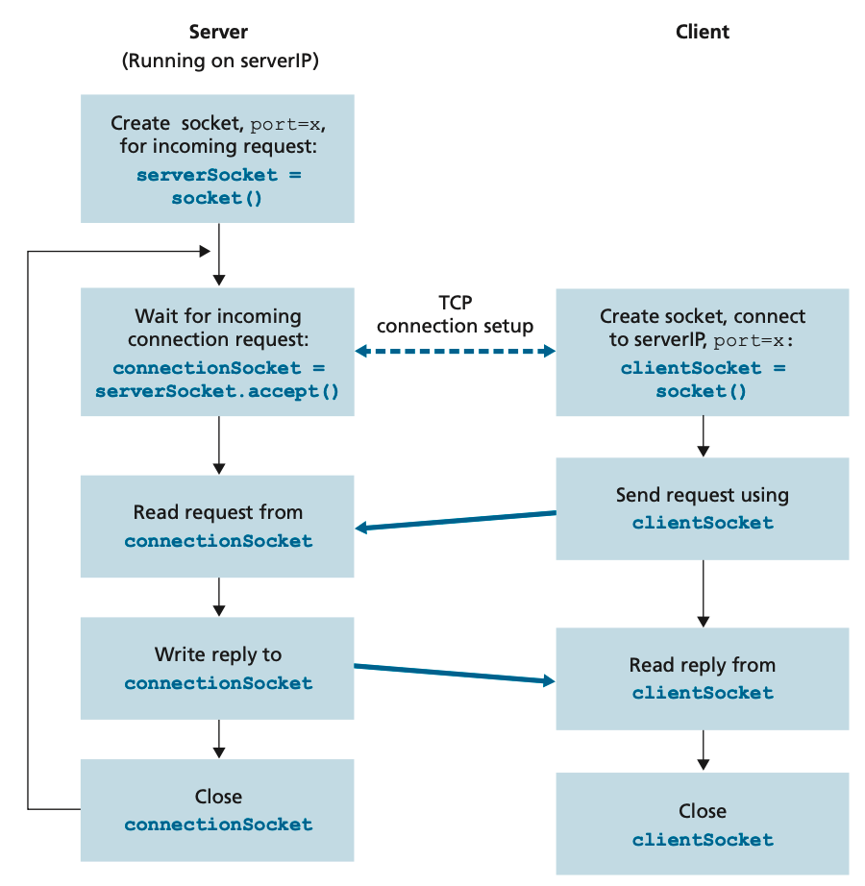
What is "socket"

Slide 52

Socket: analogous to a door
client computer
4
6
77
8
socket( ): create a “door”
bind( ): tie the door to a [local IP addr, port#] pair
131.179.128.19
connect()
close(): delete/remove a door
A couple other questions:
What is the server’s IP address?
Website name → IP address
What port number to use?
Client: assigned by OS
Server: defined standards
server computer
2
3
4
11
28
6
216.58.219.46
listen( ): start waiting for incoming packet with matching destination port#
Notes:
accept( ): accept a new connection
Write( ): write data to a socket
Read( ): read data from a socket

Slide 53
A quick comment about "port"
Web request
Email request
FTP request
A server for email, web, ftp
Web, Email, FTP all connect client to server by TCP
The server tells which client wants which service by well-defined port number:
Web: port 80, ftp 21, mail 25
ftp:waiting for packets to port21
email process: port25
Web server: port80

Slide 54



IP address, TCP connection, port number, processes, and sockets
email server
process
web server
process
port=25
port=80
Operating system
(including TCP, IP)
Apple Mail
process
web browser
process
Port=4567
IP address: 131.179.128.19
port=2345
18.2.3.4
12.2.3.4
Notes:
Port numbers: below 1024 are controlled by IANA, Internet Assigned Numbers Authority
Individual user processes are assigned port numbers when creating a socket

Slide 55
Applications
So far we’ve talked
Application process (executing application program)
Application protocol (used by application processes to exchange data)
Exactly how data is exchanged
Socket
Transport protocol
Lets look at exactly what data is exchanged
process
socket
TCP with
buffers,
variables
Notes:
Sink into the hole of socket, then transport carries the data to the other end

Slide 56
Web and HTTP
Web page: normally consists of
base HTML-file, which includes
several referenced objects
An object can be another HTML file, JPEG image, Java applet, audio file,…
Each object is addressable by a URL (Universal Resource Locator )
http://www.someschool.edu:port#/someDept/pic.gif
host name
path name
Application protocol
Notes:
Port# is optional; use default if absent; explain 2 slides down
Path name:directory+file name

Slide 57
What protocol “layer” really means
application
transport
network
link
physical
Link
layer
protocol
Network
protocol
Transport
protocol
Application
protocol
Application
data

Slide 58
Acknowledgment
Slides adapted from S24 CS118 instructed by Prof. Lixia Zhang

